Slide 1
Network Layer Design Issues
The network layer or layer 3 of the OSI (Open Systems Interconnection) model is concerned delivery of data packets from the source to the destination across multiple hops or links.
It is the lowest layer that is concerned with end − to − end transmission.
The designers who are concerned with designing this layer needs to cater to certain issues.
These issues encompasses the services provided to the upper layers as well as internal design of the layer.
Store - and − Forward Packet Switching
Services to Transport Layer
Providing Connection Oriented Service
Providing Connectionless Service

Slide 2
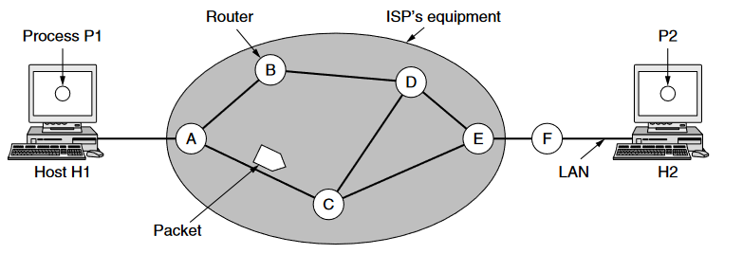
Store−and−Forward Packet Switching
The network layer operates in an environment that uses store and forward packet switching.
The node which has a packet to send, delivers it to the nearest router.
The packet is stored in the router until it has fully arrived and its checksum is verified for error detection.
Once, this is done, the packet is forwarded to the next router.
Since, each router needs to store the entire packet before it can forward it to the next hop, the mechanism is called store − and − forward switching.

Slide 3
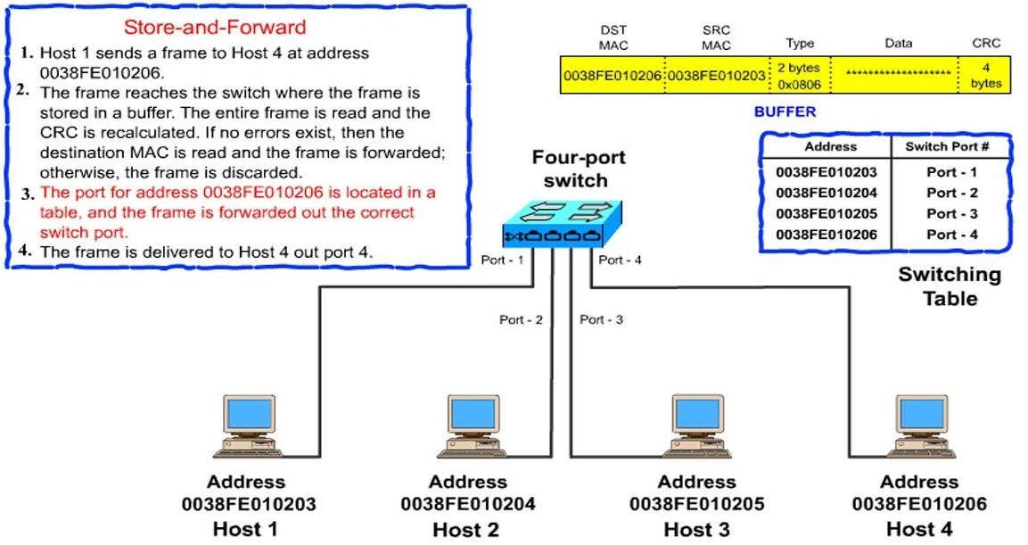
Illustration of Store and Forwarding Packet Switching

Slide 4
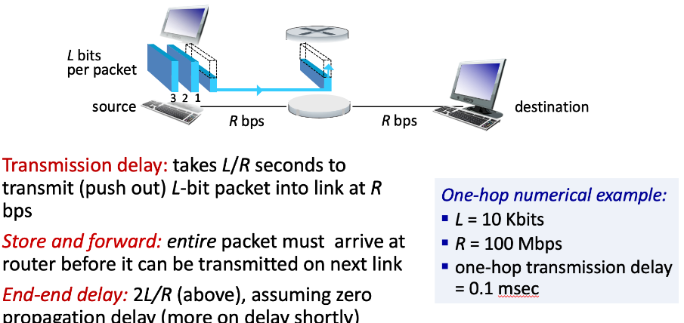
Store−and−Forward Packet Switching
In store-and-forward mode, switches receive and store the entire frame before making any operational decision.
This approach is good for keeping the integrity and validity of the frames but creates additional network latency.

Slide 5
Store−and−Forward Packet Switching
Benefits :
Store − and - forward packet switching ensures high quality data packet transmission.
Since erroneous packets are discarded at each router, bad packets or invalid packets in the network are mostly eliminated.
However, error−free packet transmission is achieved by compromising on the overall speed of transmission.
Limitations :
Switch latency is introduced due to waiting for entire packet to arrive as well as computation of CRC.
Though the latency at each router may seem small enough, the cumulative latency at all routers make it inappropriate for time − critical online applications.

Slide 6
Cut-Through Packet Switching
Cut-through is a packet-switching method, where the switch forwards a packet as soon as the destination address is processed without waiting for the entire packet to be received.
The next packet is sent as soon as the previous one has been verified as reaching the recipient without waiting for the complete transmission of the previous packet.
Working : In cut-through switching, whenever a packet arrives at the switching device, data transmission is started as soon as the destination address is processed.
The switch performs a look–up operation in the address table to check whether the destination address is valid or not.
If the address is valid and the outgoing link is available then the switching device immediately transmits the frame to the destination port.
Switch use Cyclic Redundancy Check (CRC) on incoming packets for error detection and marks corrupted frame EOF field as invalid. It relies on the destination devices for error handling of the corrupted data. The destination devices detect the invalid flag and drop the frame.

Slide 7
Cut-Through Packet Switching
Store-and-Forward Switching | Cut-Through Switching
Support error checking. Through CRC checking, Ethernet frames will be dropped if it’s smaller than 64 bytes in length (a runt) or larger than 1518 bytes in length (a giant). Error-free forwarding. Bad frames will be discarded before forwarding. Support automatic buffering. The entire frames will be stored. Waiting time (switch latency) is a little long. It takes time to store the entire frame in the switch. High level of error-free data transmission. | Invalid frames exist. Ethernet frames with or without errors will be forwarded to destination port if its first 6 bytes is recognized. Bad frames will be forward too, which will cause amounts of error frames. Wait time (switch latency) is very low. Because the switch will not store the entire frames or packets.

Slide 8
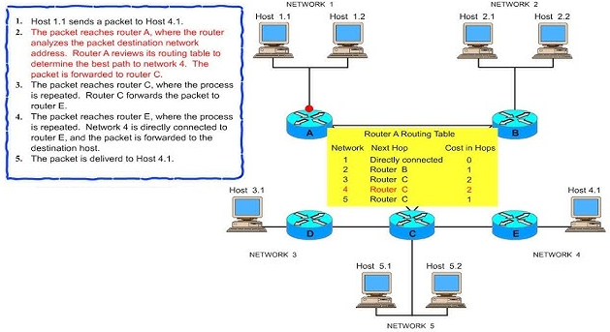
Cut-Through Packet Switching

Slide 9
Services to Transport Layer
Logical Addressing − Network layer adds header to incoming packet which includes logical address to identify sender and receiver.
Routing − It is the mechanism provided by Network Layer for routing the packets to the final destination in the fastest possible and efficient way.
Flow control − This layer routes the packet to another way, If too many packets are present at the same time preventing bottlenecks and congestion.
Breaks Large Packets − Breaks larger packets into small packets.
Connection Oriented service − It is a network communication mode, where a communication session is established before any useful data can be transferred and where a stream of data is delivered in the same order as it was sent.

Slide 10
Services to Transport Layer
Connectionless Service− It is a data transmission method used in packet switching networks by which each data unit is individually addressed and routed based on information carried in each unit, rather than in the setup information of a prearranged, fixed data channel as in connection-oriented communication.
DataGram − A datagram is a basic transfer unit associated with a packet-switched network. The delivery, arrival time and order of arrival need not be guaranteed by the network.
A virtual circuit − It is a means of transporting data over a packet switched computer network in such a way that it appears as though there is a dedicated physical layer link between the source and destination end system of this data.

Slide 11
Implementation of Connection Oriented Service
For connection-oriented service, we need a virtual-circuit network.
The idea behind virtual circuits is to avoid having to choose a new route for every packet sent.
When a connection is established, a route from the source machine to the destination machine is chosen as part of the connection setup and stored in tables inside the routers.
That route is used for all traffic flowing over the connection, exactly the same way that the telephone system works.
When the connection is released, the virtual circuit is also terminated. With connection-oriented service, each packet carries an identifier telling which virtual circuit it belongs to.

Slide 12
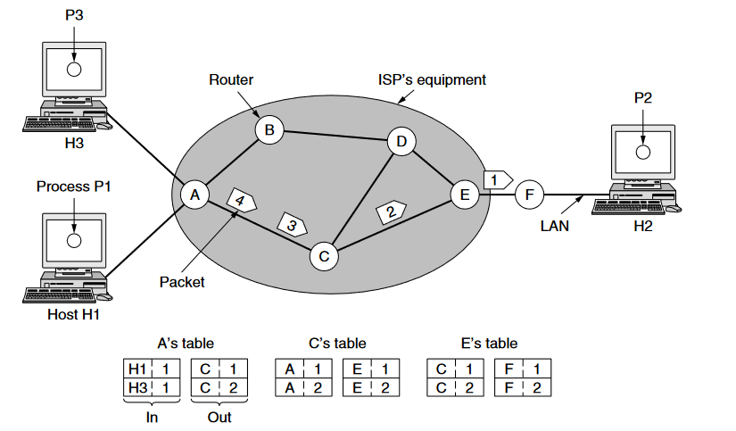
Implementation of Connection Oriented Service
We have a conflict here be-cause although A can easily distinguish connection 1 packets from H1 from connection 1 packets from H3, C cannot do this.
For this reason, A assigns a different connection identifier to the outgoing traffic for the second connection. Avoiding conflicts of this kind is why routers need the ability to replace connection identifiers in outgoing packets.

Slide 13
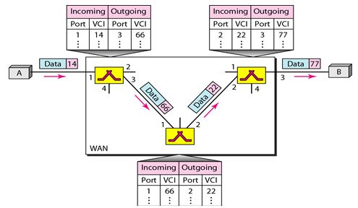
Implementation of Connection Oriented Service-Virtual Circuit

Slide 14
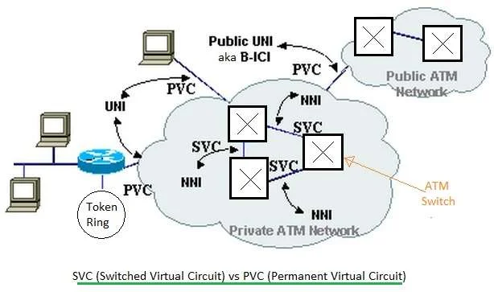
Implementation of Connection Oriented Service-Virtual Circuit

Slide 15
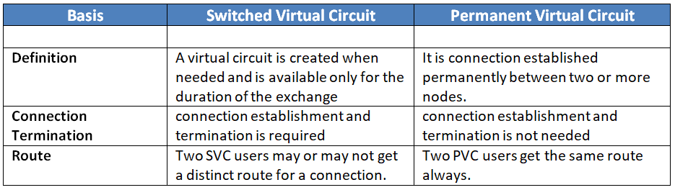
Implementation of Connection Oriented Service-Virtual Circuit

Slide 16
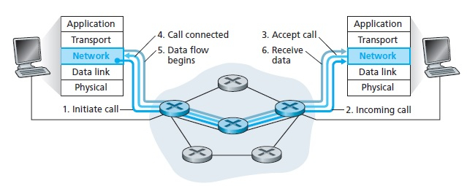
Implementation of Connection Oriented Service
The pictorial representation of virtual circuit connection over a telephone call is as follows:
It is a network where a virtual connection is established between source and the destination. Through this network, packets will be transferred during any call.
The path established between two points appears as a dedicated physical circuit. Therefore, it is called a virtual circuit. It is a type of packet switching.
It is a connection-oriented service, where the first packet goes and reserves the resources for the subsequent packets.
For examples − X.25 and frame relay.

Slide 17
Implementation of Connection Oriented Service
Benefits of Virtual Circuits :
Packets are delivered in the same order as they all follow the same route between the source & the destination.
The overhead is smaller as full address is not required on each packet as they all follow the same established path.
The connection is more reliable as it is one to one connection.
Less chances of data loss.
Limitations of Virtual Circuits:
The switching equipment should be powerful.
Re-establishment of the network is difficult as if there is any failure.
All calls need to be re-established.

Slide 18
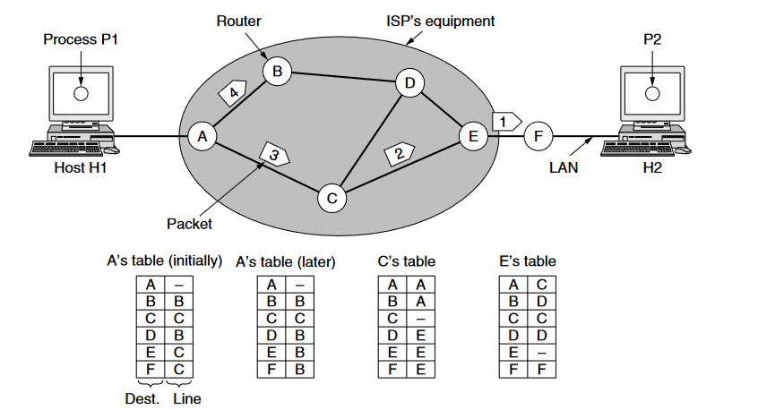
Implementation of Connectionless Oriented Service
When connectionless service is offered, packets are frequently called Datagrams because individual packets are injected to the subnet and are routed individually.
No advance setup is required. Subnets are called Datagram subnets.
The algorithm that manages the tables and makes the routing decisions is called the routing algorithm.
IP (Internet Protocol), which is the basis for the entire Internet, is the dominant example of a connectionless network service. Each packet carries a destination IP address that routers use to individually forward each packet. The addresses are 32 bits in IPv4 packets and 128 bits in IPv6 packets.

Slide 19
Implementation of Connectionless Oriented Service
Benefits :
It is very fast and also allows for multicast and broadcast operations in which similar data are transferred to various recipients in a single transmission.
The effect of any error occurred can be reduced by implementing error-correcting within an application protocol.
This service is very easy and simple and is also low overhead.
At the network layer, host software is very much simpler.
No authentication is required in this service.
Some of the application doesn’t even require sequential delivery of packets or data. Examples include packet voice, etc.

Slide 20
Implementation of Connectionless Oriented Service
Limitations :
This service is less reliable as compared to connection-oriented service.
It does not guarantee that there will be no loss, or error occurrence, misdelivery, duplication, or out-of-sequence delivery of the packet.
They are more prone towards network congestions.
Q1. Packets of the same session may be routed through different paths in:
a. TCP, but not UDP
b. TCP and UDP
c. UDP, but not TCP
d. Neither TCP nor UDP
Q2. A program on machine 𝑋 attempts to open a 𝑈𝐷𝑃 connection to port 5376 on a machine 𝑌, and a 𝑇𝐶𝑃 connection to port 8632 on machine 𝑍. However, there are no applications listening at the corresponding ports on 𝑌 and 𝑍. An 𝐼𝐶𝑀𝑃 Port Unreachable error will be generated by
a. 𝑌 but not 𝑍 b. 𝑍 but not c. Neither 𝑌 nor 𝑍 d. Both 𝑌 and Z

Slide 21
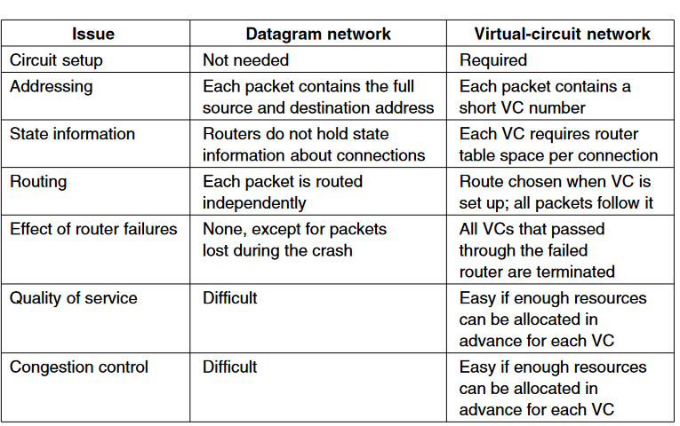
Comparison of Virtual circuits and Datagram Networks

Slide 22
Comparison of Virtual circuits and Datagram Networks
Parameters | Connection-oriented Services | Connectionless Services
Requirement of prior Connection | Establishing a connection of data packets in prior is a prerequisite. | It doesn’t necessarily establish any connection between the receiver and the host (in prior).
Congestion | No congestion occurs due to an organized data transfer. | It is very likely to cause congestion in a network.
Mode of Transfer | It performs data transfer using virtual circuits and circuit switching. | It performs data transfer with the help of packet switching.
Retransmission of Lost Data | It can easily retransmit data that might get lost on the way to the receiver’s device. | Retransmitting any lost data is not practically possible. It cannot bring back the information lost in the way.
Signalling | It supports signalling for establishing a connection. | The concept of signalling does not exist in this case because it doesn’t establish any prior connection.
Suitability | It is the best mode for steady and long communication among distant devices. | It works well in the cases of bursty transmissions.

Slide 23
Comparison of Virtual circuits and Datagram Networks
Parameters | Connection-oriented Services | Connectionless Services
Forwarded Data Packets Sequence | The transmitted packets travel to their intended destination in a sequence. They follow the same initial route, and they reach the destination in the same sequence. | The transmitted data packets do not necessarily follow their intended route and reach the destination randomly. There is no assurance of these packets following the same path.
Allocation of Resources | It allocates resources to the data packets before transmitting them to a network. | Allocation of resources to the information packets is not a prerequisite in this case.
Dependability | This type of connection service is much more dependable. | It is not very dependable. Data may not arrive in the intended sequence and also may get lost in the way.
Bandwidth | Transferring data in a connection-oriented service takes up a higher bandwidth. | A connectionless service requires a comparatively lower bandwidth for transferring the data.
Virtual Path | A virtual path is present between the receiver and the server. | No virtual path is present between the receiver and the server.

